Slide 1
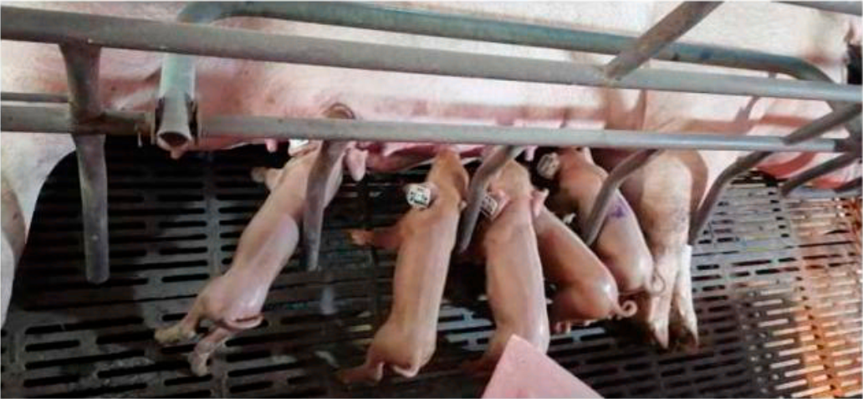
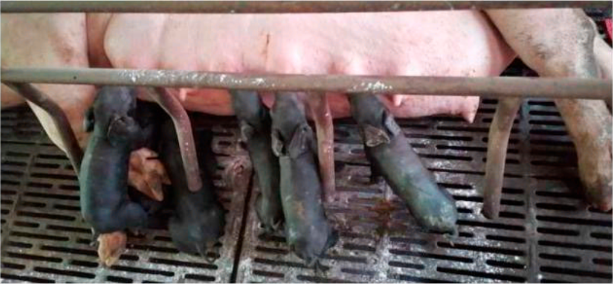
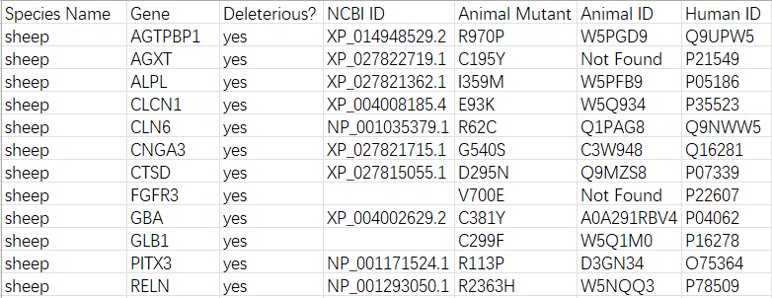










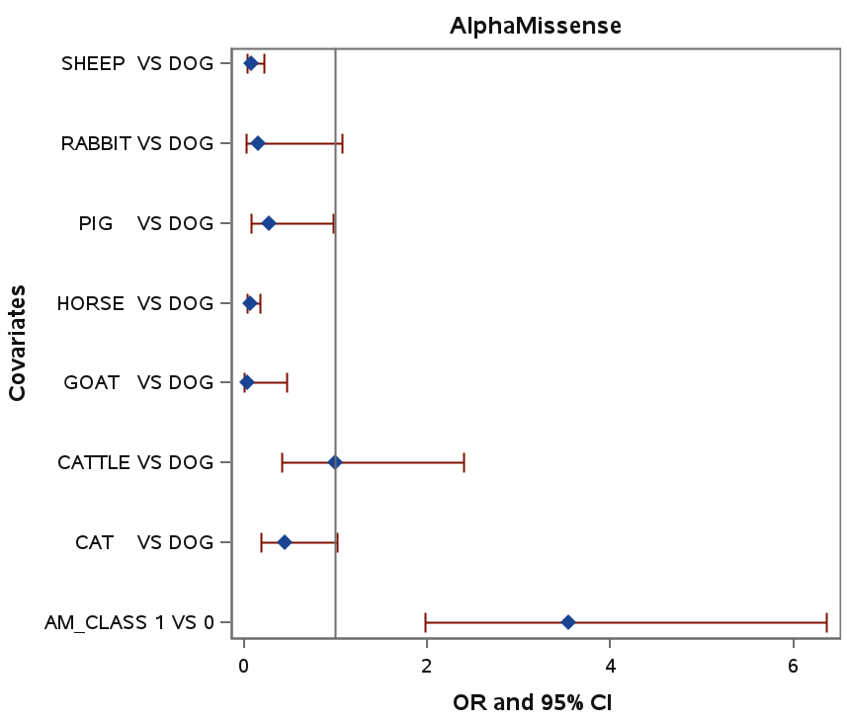
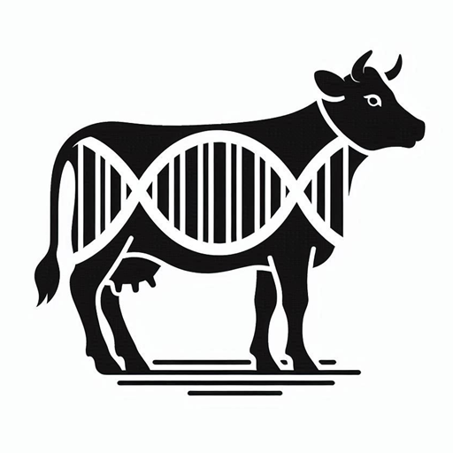
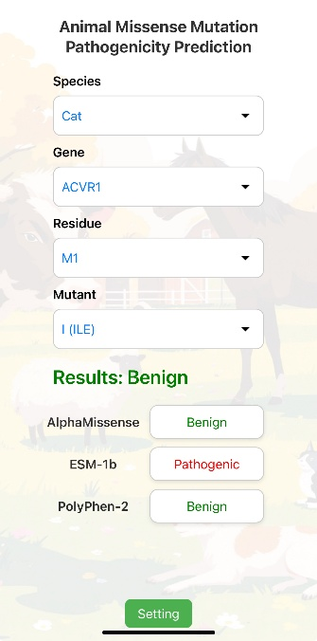
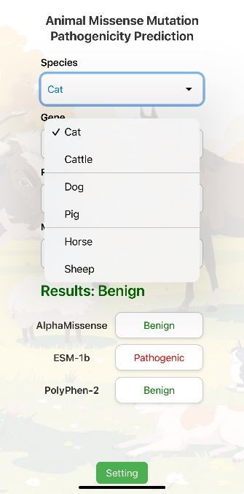
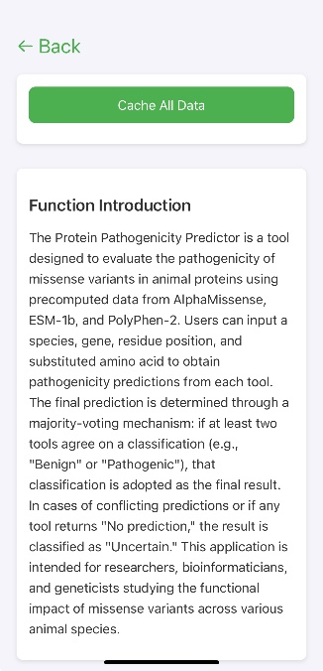
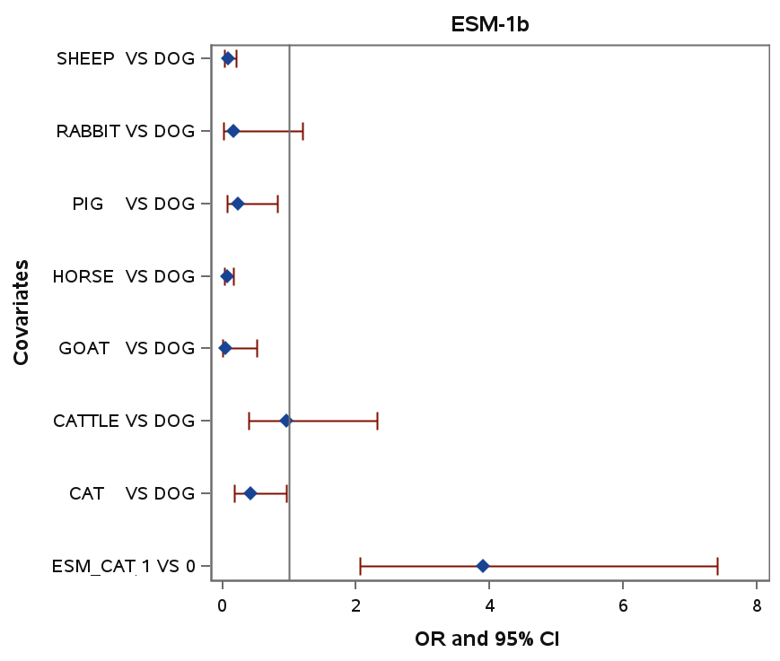
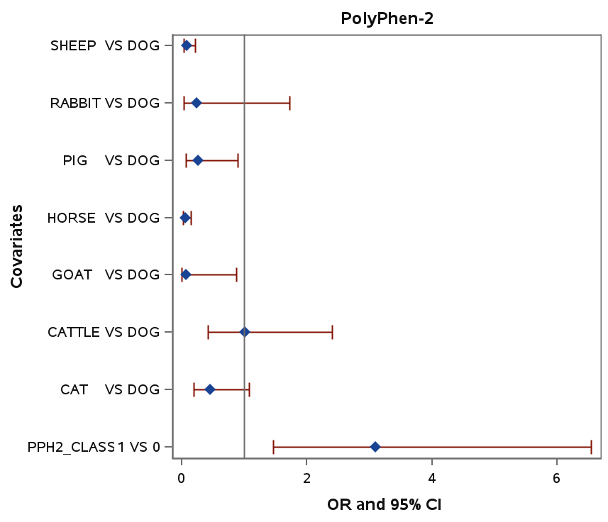
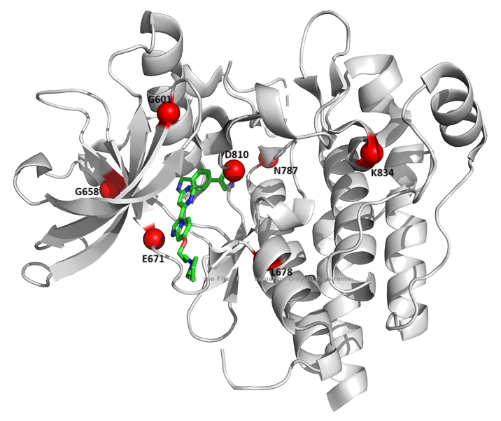
Can Human Genomic Tools Predict the Pathogenicity of Rare Missense Variants in Domesticated Mammals?
ABSTRACT
Study Procedures
Potential Application
Predicting the pathogenicity of missense variants has significant potential for improving animal disease diagnosis, breeding, and veterinary care. However, no genomic tools have been specifically developed for animals. This study employed a “mock” human missense variant approach to assess the performance of three human genomic tools (AlphaMissense, ESM-1b, and PolyPhen-2) using 374 missense variants across 236 animal proteins from 8 domestic mammal species, sourced from the Online Mendelian Inheritance in Animals (OMIA) database. These tools demonstrated moderate overall prediction accuracy, with an area under the receiver operating characteristic curve (auROC) of 0.55–0.61, though performance varied significantly across species, ranging from 0.50 in horses to 0.76 in cats. High sensitivity (0.77–0.90) reflected strong detection of potentially pathogenic variants, whereas low specificity (0.20–0.46) likely resulted from discrepancies between OMIA’s 'non-deleterious' classification and the 'benign' label used by these tools. An interesting potential application of this study emerged in manipulating pig coat color through MC1R gene editing, underscoring the practical implications of pathogenicity prediction in animal breeding. A prototype app was developed to enable users to predict the pathogenicity of missense variants in domestic mammals. Overall, this study highlights the adaptability of human genomic tools for domestic animal applications using a “mock” human variant strategy, though results require careful interpretation due to species-specific differences in pathogenicity definitions and protein functions.
OMIA
1,636 variant records across 602 animal species
excluding humans and mice.
Aligned Protein Sequences
Animal: EVTMVPGKGPSFPEPLREE-RDLERLRDP-ATV-AS
Human: EVTMVPGKGPSFPEPLREEQ-DLERLRDPE--VVAS
******************* ******** * **
Animal: ELGYVFQAITLTRQ-QLAGRVPLIGFAGAPWTLMTY
Human: ELGYVFQAITLTRQR-LAGRVPLIGFAGAPWTLMTY
**************** ******************
Animal: MVEGGGSSTM-SQAKRWLYQRPQASHQL
Human: MVEGGGSSTMA-QAKRWLYQRPQASHQL
********** ****************
Black coat color in pigs is determined by the dominant E allele at the MC1R locus. Four missense mutations in this locus are believed to function in eumelanin synthesis. Researchers replaced all four missense mutations, successfully transforming red-skinned Duroc pigs into black ones [6] (Figure 7).
Our study indicated that only one of these four missense mutations is pathogenic. Editing this single mutation could yield the same result, significantly simplifying the procedure and reducing costs (Figure 8).
374 “Mock” Human Missense Variants
Data Collection
Human
Genomic tools
Data Cleaning
Sequence Alignment
Data Preparation
Animal Protein Sequence
EVTMVPGKGPSFPEPLREERDLERLRDPATVASELGYVFQAITLTRQQLAGRVPLIGFAGAPWTLMTYMVEGGGSSTMSQAKRWLYQRPQASHQL
432 Animal
Missense Variants
Human Homologous
Protein Sequence
EVTMVPGKGPSFPEPLREEQDLERLRDPEVVASELGYVFQAITLTRQRLAGRVPLIGFAGAPWTLMTYMVEGGGSSTMAQAKRWLYQRPQASHQL
Pathogenicity Prediction
Output
Prediction Performance
Analyses
A
B
Methodology Adapted for Application Development
Figure 7: A: Wild-type Duroc pig. B: Dark black Duroc pig with MC1R modification
Images taken form Ref.[6]
OMIA_work dataset
95
102
164
243
RESULTS
V
L
V
T
BACKGROUND
374 animal missense variants across 236 proteins were used, with the majority belonging to dogs, cattle, and cats (Figure 1).
OMIA classified 284 as deleterious (pathogenic) and 90 as non-deleterious (benign). AlphaMissense, ESM-1b, and PolyPhen-2 identified 267, 305 , and 323 variants as pathogenic, and 107, 69, and 45 as benign, respectively (Figure 2).
All three tools showed moderate prediction accuracy (auROC 0.55–0.61), high sensitivity (0.77–0.90), and low specificity (0.20–0.46) (Figure 3).
Adjusted analysis indicated that species is a key factor significantly associated with pathogenicity prediction (Figure 4).
Prediction performance varied across species (auROC ranging from 0.50 for horses to 0.76 for cats) (Figure 5).
M
P
A
A
Advances in gene sequencing technologies have enabled the exploration of genetic mutations in livestock and companion animals, offering significant potential for improving breeding and farming practices.
Missense variants often have complex and subtle effects on protein structure and function, making their interpretation challenging yet critical.
Current genomic tools are primarily designed to predict the pathogenicity of human missense variants, and their applicability to animal genomes remains uncertain. Equivalent tools specifically tailored for domestic animals are still underdeveloped, highlighting a critical gap in animal genomics research[1].
V
L
A
A
Figure 8: Pathogenicity prediction of four missense mutations of MC1R.
Red : predicted to be pathogenic ； green: predicted to be benign
prototype app
126
93
60
29
43
15
5
3
Fueled by The Three Tools – Uses the three human genomic tools.
Predictions Made Simple – Just input species, gene, and variant; get prediction.
Decision Made by Majority – Final call based on agreement of ≥2 tools.
Expansion Made Easy – Modular design for future data or models.
Ready for Offline Use – No dependency on live servers.
Figure 1: Distribution of 374 missense variants across eight species
AniMisPath
Animal Protein Missense Variant Pathogenicity Predictor
OBJECTIVE
To evaluate the performance of three human genomic tools (AlphaMissense[2], ESM-1b[3], and PolyPhen-2[4]) in predicting the pathogenicity of known missense variants of domestic mammals.
Figure 9: Screen shots of AniMisPath
Figure 2: Pathogenic and benign predictions of “mock” human variants by AlphaMissense, ESM-1b, and PolyPhen-2, compared to OMIA classification
STRENGTHS AND LIMITATIONS
METHODS
Strengths
This is the first systematic evaluation of human-based tools using the "mock" strategy for missense variant prediction in domestic mammals.
The results highlighted the protein function-pathogenicity discrepancy as a key limitation in cross-species prediction.
The prototype app enabled rapid animal missense variant assessment.
Limitations
Not all animal mutations could be predicted due to absence of corresponding human protein residues.
Small size of the OMIA dataset may introduce prediction biases.
Only three human genomic tools were evaluated in this study.
Data Collection: Obtained domestic animal's variant data from the Online Mendelian Inheritance in Animals database (OMIA)[5].
Data Cleaning: Purged and cleaned the data by retaining only missense variants from eight domestic mammals (Dogs, Cattle, Cats, Horses, Sheep, Pigs, Goats and Rabbits).
Data Preparation: Wrote Python scripts to fetch both animal and human homologous protein data (ID, Entry Name, Sequence ) from the UniProt and NCBI databases.
Variant Mapping: Wrote Python scripts to verify animal missense variants and map to their corresponding residues on the human homologous proteins, then generated the “mock” human variants.
Pathogenicity Prediction: Wrote Python scripts to apply three human genomic tools (AlphaMisense, ESM-1b, PolyPhen-2) to predict the pathogenicity of the “mock” human variants.
Data Analysis: Used SAS® to examine the prediction performance of the three human genomic tools (including descriptive and logistic regression analyses).
Variants Visualization: Used PyMOL to map missense variants on 3D protein structures and visualize interactions with nearby residues.
App Development: Developed a Progressive Web Application (PWA) using HTML, CSS, JavaScript, and Python. The server housed pre-aligned homologous protein sequences for animals and humans, along with precomputed prediction scores derived from AlphaMissense, ESM-1b, and PolyPhen-2. The application featured seamless distribution and accessibility, enabling efficient data handling and user interaction.
Figure 3: Performance of AlphaMissense, ESM-1b, and PolyPhen-2 in predicting pathogenicity of “mock” human variants compared to the average auROC for humans from the literature
Figure 4: Forest plots of odds ratios and 95% confidence intervals (CIs) from logistic regressions in predicting pathogenicity
CONCLUSIONS
auROC : area under the receiver operating characteristic curve, auROC-H : Average auROC (based on three human datasets) from the literature; auROC-M : auROC obtained in this study with 374 variants from eight domestic mammals
Figure 5: Prediction performance for cattle, cats, dogs, horses, and sheep
Human genomic tools (AlphaMissense, ESM-1b, and PolyPhen-2) demonstrated moderate overall accuracy in interpreting selected missense variants in domestic mammals from the OMIA dataset using the "mock" strategy, showing high sensitivity but low specificity.
The high sensitivity suggested that these tools, combined with the "mock" strategy, were effective at detecting variants associated with severe or lethal diseases in domestic mammals, and may have potential for improving breeding and farming practices.
The low specificity likely arose from a conceptual mismatch between the OMIA-defined term "non-deleterious" and the "benign" classification used in genomic tools.
Relevant tools, such as the prototype app, may facilitate the quick assessment of animal missense variants.
Most of the 284 variants classified as deleterious in OMIA were predicted to be pathogenic by at least one tool, with the majority associated with severe or lethal diseases.
Of the 90 variants classified as non-deleterious in OMIA, 59 were predicted to be pathogenic by at least two tools, with the majority associated with traits such as coat color, involving genes like MC1R and KIT.
The term 'non-deleterious' as defined in OMIA may not fully align with the concept of 'benign' used in genomic tools, which typically implies that a mutated gene retains normal or near-normal function. This discrepancy could contribute to reduced specificity in predictions.
As demonstrated by mapping KIT variants onto the 3D protein structure, non-deleterious variants predicted as pathogenic tend to have a significant impact on protein function (Table 1, Figure 6).
Animal Variant | Species | OMIA Classification | “Mock” Human Variant | Phenotypic Outcomes | Prediction
G597R | Horse | non-deleterious | G601R | White coat | Pathogenic
A602V | Horse | non-deleterious | A606V | White coat | Pathogenic
G654R | Horse | non-deleterious | G658R | White coat | Pathogenic
L674H | Horse | non-deleterious | L678H | White coat | Pathogenic
L674P | Horse | non-deleterious | L678P | White coat | Pathogenic
E667D | Horse | non-deleterious | E671D | White coat | Pathogenic
N783Y | Horse | non-deleterious | N787Y | White spotting | Pathogenic
K830I | Horse | non-deleterious | K834I | White coat | Pathogenic
KEY REFERENCES
Figure 6: Mapping of 8 “mock” human MC1R variants onto the 3D X-ray crystal structure of hC-Kit Kinase Domain (PDB ID: 1PKG)
Yang, Y., A. Shao, and M. Vihinen, PON-All: Amino Acid Substitution Tolerance Predictor for All Organisms. Front Mol Biosci, 2022. 9: p. 867572.
Cheng, J., et al., Accurate proteome-wide missense variant effect prediction with AlphaMissense. Science, 2023. 381(6664): p. eadg7492.
Brandes, N., et al., Genome-wide prediction of disease variant effects with a deep protein language model. Nat Genet, 2023. 55(9): p. 1512-1522.
Adzhubei, I.A., et al., A method and server for predicting damaging missense mutations. Nat Methods, 2010. 7(4): p. 248-9.
Nicholas, F.W., Tammen, I., & Sydney Informatics Hub, Online Mendelian Inheritance in Animals (OMIA). 2025.
Zhong H, Zhang J, Tan C, Shi J, Yang J, Cai G, Wu Z, Yang H. Pig Coat Color Manipulation by MC1R Gene Editing. Int J Mol Sci. 2022 Sep 8;23(18):10356.
Table 1: The 8 KIT gene variations classified as non-deleterious (benign) in OMIA

